Slide 1
Chapter 6: Windows Server 2025 Security & Hardening
Security hardening from hardware trust to policy enforcement

Slide 2
Learning Objectives
01 Explain the layered security model in Windows Server 2025
02 Describe Secured-core server hardware requirements and protections
03 Explain VBS, HVCI, and Credential Guard and their role in credential protection
04 Apply SMB security hardening: signing, encryption, NTLM blocking, and QUIC
05 Deploy Windows Firewall hardening across Domain, Private, and Public profiles
Windows Server 2025 | Chapter 6 | Security & Hardening
02

Slide 3
6.1 Security Concepts: Layered Defence

Slide 4

6.1 Security Concepts: Layered Defence
Security starts before user sign-in
Hardware, firmware, OS, identity, and network controls all matter
Security is verified, monitored, and maintained over time
Secured-core server is the clearest platform example
Strong security depends on both platform capability and correct configuration
Windows Server 2025 | Chapter 6 | Security & Hardening
04

Slide 5
Windows Server Security Layers
Firewall, Baselines & Hardening
Policy, drift management
5
Credential Protection & Least Privilege
LSA isolation, LAPS, JEA
4
Virtualization-Based Security & Isolated Security Functions
Credential Guard, HVCI
3
Boot Protections & Platform Trust
Measured boot, UEFI integrity
2
TPM 2.0 & Secure Boot
Hardware-rooted trust
1
Windows Server 2025 | Chapter 6 | Security & Hardening
05

Slide 6

Secured-Core and Security Baselines
Secured-core combines hardware, firmware, and virtualisation-backed protections
Security baselines help standardise hardening across deployments
Validation is required before broad rollout
Security posture depends on capability AND correct configuration
Baselines reduce drift — but do not replace operational review and monitoring
Secured-core is not a single toggle. Baselines are not blindly applied without testing — always validate in a non-production environment first.
Windows Server 2025 | Chapter 6 | Security & Hardening
06

Slide 7
Virtualization-Based Security & Credential Guard
VBS uses the Hyper-V hypervisor to create an isolated secure memory region outside the normal OS
HVCI (Hypervisor-Protected Code Integrity) runs kernel code integrity checks inside VBS — prevents unsigned or malicious drivers loading
Credential Guard isolates NTLM hashes and Kerberos TGTs in a VBS-protected LSA process (LSAIso.exe)
Credential Guard is enabled by default in Windows Server 2025 on domain-joined, non-DC systems that meet hardware requirements
LSA Protection (PPL) prevents memory dumping of LSASS — complements Credential Guard; enabled by default in WS2025
Protects against Pass-the-Hash, Pass-the-Ticket, and credential-dumping attacks (e.g. Mimikatz)
Hardware requirements: UEFI 2.3.1+, Secure Boot, 64-bit CPU with virtualisation extensions, SLAT, TPM 2.0 recommended
Windows Server 2025 | Chapter 6: Security & Hardening
Windows Server 2025 | Chapter 6 | Security & Hardening
07

Slide 8
SMB
Signing & Encryption
SMB signing required by default for ALL outbound connections (previously only SYSVOL/NETLOGON)
SMB encryption enforced for all outbound client connections
Dialect control: enforce SMB 3.1.1 minimum; block legacy protocols
NTLM & Authentication
SMB NTLM blocking: prevents downgrade from Kerberos on outbound connections
Authentication rate limiter: delays failed NTLM/PKU2U attempts — blocks brute force
Guest authentication blocked by default (prevents adversary-in-the-middle scenarios)
SMB over QUIC
Now available in Standard and Datacenter (was Azure Edition only in WS2022)
Encrypted SMB over UDP/443 (TLS 1.3) — no VPN required for remote users
Client access control: certificate allowlist/blocklist for QUIC connections
Firewall & Protocol
New restrictive firewall rule group — NetBIOS ports 137-139 no longer opened by default
Remote Mailslots disabled by default (deprecated — no auth or authorisation)
RRAS: PPTP and L2TP VPN disabled by default; use SSTP or IKEv2
Windows Server 2025 | Chapter 6 | Security & Hardening
08

Slide 9
Windows Firewall Hardening
Profile-Based Enforcement
Domain, Private, and Public profiles — each with independent inbound/outbound rules
Baseline sets all profiles: inbound default BLOCK, outbound default ALLOW
Notifications disabled by default in hardened configurations to prevent user bypass
Key Hardening Actions
Block local policy merge on Public profile — prevents user rule overrides
Disable unicast responses to multicast/broadcast (Public profile)
SMB share creation now uses restrictive rule group — NetBIOS ports 137-139 excluded
PowerShell Management
Get-NetFirewallProfile
Set-NetFirewallProfile -Profile Public -DefaultInboundAction Block
Get-NetFirewallRule | Where-Object Enabled -eq True
Instructor Notes
OSConfig security baseline auto-configures all three firewall profiles
Windows Admin Center provides a visual rule editor for Server Core deployments
Audit: Force subcategory settings to override category settings — required for advanced audit policy
Test firewall rules in a lab environment before applying to production domain
Windows Server 2025 | Chapter 6: Security & Hardening
Windows Server 2025 | Chapter 6 | Security & Hardening
09

Slide 10
Windows Server 2025 Security Baseline - Detail
What It Is
How to Apply
Over 300 Group Policy settings via the Security Compliance Toolkit (SCT)
Covers password policy, audit logging, SMB, Kerberos, RDP, UAC, and more
Versioned releases — latest v2602 (Feb 2026); updated more frequently than prior Server baselines
Separate DC and Member Server profiles
OSConfig (new for WS2025): PowerShell-based with drift control — re-applies if settings change
Group Policy / GPO: import baseline GPO backup via the SCT
Windows Admin Center and Azure Policy: for at-scale and Arc-connected deployments
Key Policy Areas (WS2025)
Deployment Guidance
SMB: signing enforced by default on DCs; 3 new audit policies for encryption/signing/guest logon
Kerberos: SHA-1 deprecation for PKINIT; ROCA-vulnerable WHfB keys blocked on DCs
NTLM: audit incoming traffic on all servers; phase-out monitoring via new audit policies
LSA Protection + VBS: UEFI-locked; prevents admin-level tampering of LSASS
Always test in a non-production environment first — applying a baseline changes default behaviours
Do not merge baseline settings into an existing corporate GPO — keep it a separate, linked GPO
Password policy: local admin password minimum length rises to 14 characters on application
Sudo command disabled by policy; Mark of the Web enforced for files from untrusted sources
Windows Server 2025 | Chapter 6 | Security & Hardening
10

Slide 11
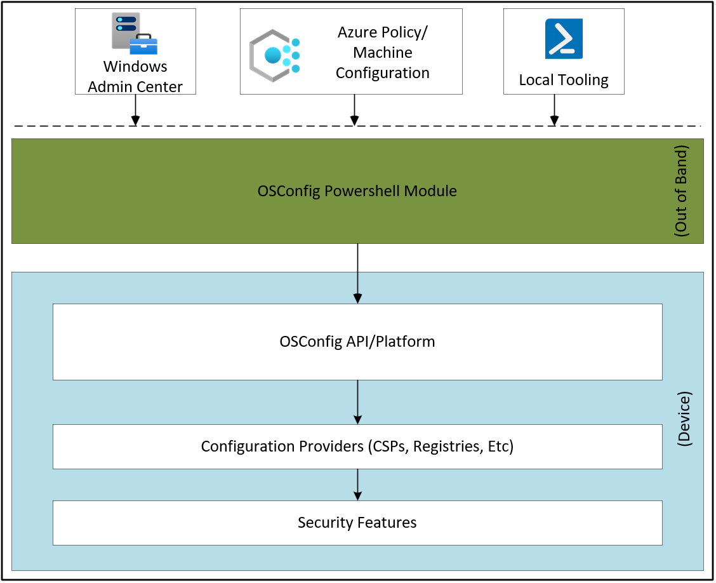
OSConfig - Security Configuration Stack
A security configuration stack that delivers and enforces desired state for on-premises and Azure Arc-connected Windows Server devices.
Key Capabilities
Drift control — auto-corrects any settings that deviate from desired state
Scenario-based profiles: e.g. SecurityBaseline/WS2025/MemberServer
Supports GPO (.admx), WMI (.mof), and CSP (DDF) configuration mappings
Management Interfaces
PowerShell
Windows Admin Center
Azure Policy
Install (PowerShell, elevated):
Install-Module -Name Microsoft.OSConfig -Force
learn.microsoft.com/windows-server/security/osconfig/osconfig-overview
https://github.com/microsoft/osconfig/tree/main/security
Windows Server 2025 | Chapter 6 | Security & Hardening
11

Slide 12
OSConfig - Profiles and Configuration
Profile
Scenario Path
Scope
Enforcements
Member Server
SecurityBaseline/WS2025/MemberServer
Domain-joined
TLS 1.2+, SMB 3+, LSASS/PPL, Kerberos AES
Workgroup Member
SecurityBaseline/WS2025/WorkgroupMember
Non-domain
Same as MemberServer + local acct policy
Domain Controller
SecurityBaseline/WS2025/DomainController
DC only
DC-specific AD, Kerberos, SYSVOL hardening
Secured-Core
SecuredCore
All servers
UEFI MAT, Secure Boot, VBS, HVCI, DRTM
Defender Antivirus
Defender/Antivirus
All servers
AV policy, real-time protection settings
PowerShell Commands
Key Considerations
Apply:
Apply before or after Azure Arc connection — reapply if server role changes
Drift control is ON by default — auto-corrects deviations via scheduled task
RDP clipboard (copy/paste) disabled — override with -Name RemoteDesktopServicesDoNotAllowDriveRedirection -Value 0
TLS 1.2+ minimum enforced — older systems may lose connectivity
SMB 3.0+ minimum — Linux Samba must support SMB 3.0 or adjust baseline
Full settings list: github.com/microsoft/osconfig/tree/main/security
Set-OSConfigDesiredConfiguration -Scenario <Profile> -Default
Verify:
Get-OSConfigDesiredConfiguration -Scenario <Profile>
Remove:
Remove-OSConfigDesiredConfiguration -Scenario <Profile>
Windows Server 2025 | Chapter 6 | Security & Hardening
12

Slide 13
Security Verification Commands
Confirm hardware-backed trust — TPM state and version
Review VBS-related status — Device Guard, HVCI
Check firewall exposure and profile state
Use verification commands to confirm real platform state — don't assume features are enabled
# Confirm TPM state
Get-Tpm
# Review Device Guard / VBS status
Get-CimInstance -Namespace root\Microsoft\Windows\DeviceGuard -ClassName Win32_DeviceGuard
# Check Windows Firewall profiles
Get-NetFirewallProfile
Windows Server 2025 | Chapter 6 | Security & Hardening
13

Slide 14
BitLocker Drive Encryption

Slide 15
How BitLocker Works
Encryption Architecture
Full Volume Encryption Key (FVEK) encrypts all data on the volume using AES (128-bit or 256-bit)
Volume Master Key (VMK) encrypts the FVEK — the VMK is what key protectors protect
Multiple key protectors can each independently decrypt the VMK — providing redundancy
TPM Boot Measurement Chain
At startup, firmware measures each component (CRTM → UEFI → bootloader) into TPM Platform Configuration Registers (PCRs)
TPM releases the VMK only when PCR values match expected state — if boot is tampered, key is not released
If PCR values change (different OS, new boot device, firmware update) BitLocker enters recovery mode
Unlock Flow (TPM Mode)
System powers on; firmware measures boot components into PCRs
TPM validates PCR values match sealed state; releases VMK
VMK decrypts the FVEK (stored encrypted on the volume)
FVEK decrypts data on-the-fly as Windows reads it; user signs in normally
Encryption Modes
XTS-AES 128-bit (default for fixed drives); XTS-AES 256-bit for higher security
Hardware encryption: offloads to drive controller if supported (use software encryption for compliance)
Windows Server 2025 | Chapter 6 | Security & Hardening
15

Slide 16
BitLocker Requirements
Hardware Requirements
TPM 2.0 — required for full protection with PCR-based boot integrity; must have SHA-256 PCR banks
UEFI (native mode) — TPM 2.0 is not supported in Legacy/CSM BIOS mode
TCG-compliant BIOS/UEFI with Static Root of Trust Measurement (SRTM) support
USB boot support (required if no TPM — startup key stored on USB flash drive)
Disk Partitioning
Two partitions required:
OS drive (NTFS) — encrypted by BitLocker
System drive (FAT32 for UEFI / NTFS for BIOS) — holds boot files, never encrypted
Enabling BitLocker on Windows Server
Install the BitLocker Drive Encryption feature via Server Manager or PowerShell
Install-WindowsFeature BitLocker -IncludeAllSubFeature -IncludeManagementTools -Restart
Verify TPM is ready before enabling encryption
Get-Tpm
Requires local Administrator rights; Group Policy can mandate backup before enabling
Without a TPM (fallback options)
USB startup key (required at every boot) — no boot integrity check
Enable via Group Policy: Computer Config → Admin Templates → Windows Components → BitLocker → OS Drives → “Require additional auth at startup”
Windows Server 2025 | Chapter 6 | Security & Hardening
16

Slide 17
Key Protectors & Where Keys Are Stored
Key Protector Types
TPM only — seamless unlock; VMK sealed in TPM against PCR values
TPM + PIN — 2FA; PIN 4–20 digits or full keyboard (enhanced PIN); entered before Windows loads
TPM + Startup Key — USB key inserted at each boot (used in high-security environments)
Recovery Password — 48-digit numerical key; used when all other protectors fail
AD Account/Group (SID) — unlocks with domain credentials; used for data drives and cluster volumes
Data Recovery Agent (DRA) — certificate-based; allows helpdesk recovery without the recovery password
Where Recovery Keys Are Stored
Active Directory DS — stored on the computer object; 48-digit password + key package; recommended for domain-joined servers
Microsoft Entra ID — for Entra-joined or hybrid devices; key retrieved from portal
Text file or printed — must be stored securely and separately from the encrypted device
Key rule: never store recovery keys on the encrypted device itself
PowerShell Commands
# List all protectors on C:
(Get-BitLockerVolume -MountPoint C).KeyProtector
manage-bde -protectors -get C:
manage-bde -status C:
Windows Server 2025 | Chapter 6 | Security & Hardening
17

Slide 18
Backing Up & Recovering BitLocker Keys
Back Up to Active Directory DS
Requires AD DS schema extended for BitLocker
$id=(Get-BitLockerVolume C:).KeyProtector | where RecoveryPassword | select -Expand KeyProtectorId
Backup-BitLockerKeyProtector -MountPoint C: -KeyProtectorId $id
manage-bde -protectors -adbackup C: -id {GUID}
Back Up to Microsoft Entra ID
Device must be Entra ID joined or hybrid joined
BackupToAAD-BitLockerKeyProtector -MountPoint C: -KeyProtectorId $id
Keys visible in Entra ID portal under device properties
Group Policy: Mandate Backup Before Enabling
Computer Config > Windows Settings > Security Settings > BitLocker Drive Encryption
Enable: “Do not enable BitLocker until recovery information is stored in AD DS”
Recovery: 48-Digit Recovery Password
At boot: press Esc at BitLocker screen → enter 48-digit key
Key ID shown on screen matches entry in AD DS / Entra ID
manage-bde -unlock C: -RecoveryPassword 123456-789...
Recovery: DRA Certificate
Data Recovery Agent (DRA) uses X.509 certificate to unlock any protected volume
Deployed via Group Policy; certificate stored in domain or PKI infrastructure
Rotate Recovery Password After Use
A used recovery key is a compromised key — rotate immediately
Remove-BitLockerKeyProtector C: -KeyProtectorId $oldId
Add-BitLockerKeyProtector C: -RecoveryPasswordProtector
Then back up new key to AD DS / Entra ID
Windows Server 2025 | Chapter 6 | Security & Hardening
18

Slide 19





Chapter 6: Key Teaching Points
Security is layered across the full platform — hardware through to operations
VBS changes the trust model by isolating sensitive functions from the OS
Baselines reduce drift — but still require testing before rollout
Least privilege remains essential at every layer
Security design choices must be revisited after patching and role changes
Windows Server 2025 | Chapter 6 | Security & Hardening
19

Slide 20

Lab 0601
Post-Installation Server Configuration and Security Hardening
In this lab, you will perform essential post-installation configuration tasks on a Windows Server. These tasks are critical for security and operational readiness. You will configure the server name, network settings, and apply security hardening measures.
Windows Server 2025 | Chapter 6 | Security & Hardening
20

